Slide 2
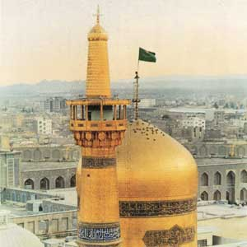
IN THE NAME OF GOD

Slide 3
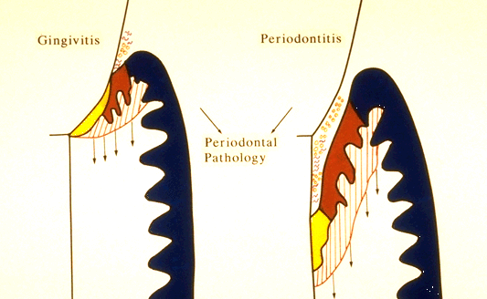
GINGIVITIS
PERIODONTITIS

Slide 4
Changes in gingiva from normal to pathologic pocket are associated with different proportions of bacterial cells in dental plaque
Healthy - coccoid cells and straigt rods
Disease - spirochetes and motile rods

Slide 5
POCKET FORMATION
Bacteria causes inflammatory change in connective tissue wall of the gingival sulcus.
Degeneration of surrounding connective tissue, including gingival fibers
Destruction of collagen fibers just apical to the junctional epithelium, this area becomes infiltrated with inflammatory cells and edema
Immediately apical to this is a zone of partial destruction and then an area of normal attachment

Slide 6
POCKET FORMATION
Bacteria causes inflammatory change in connective tissue wall of the gingival sulcus.
Degeneration of surrounding connective tissue, including gingival fibers
Destruction of collagen fibers just apical to the junctional epithelium, this area becomes infiltrated with inflammatory cells and edema
Immediately apical to this is a zone of partial destruction and then an area of normal attachment

Slide 7
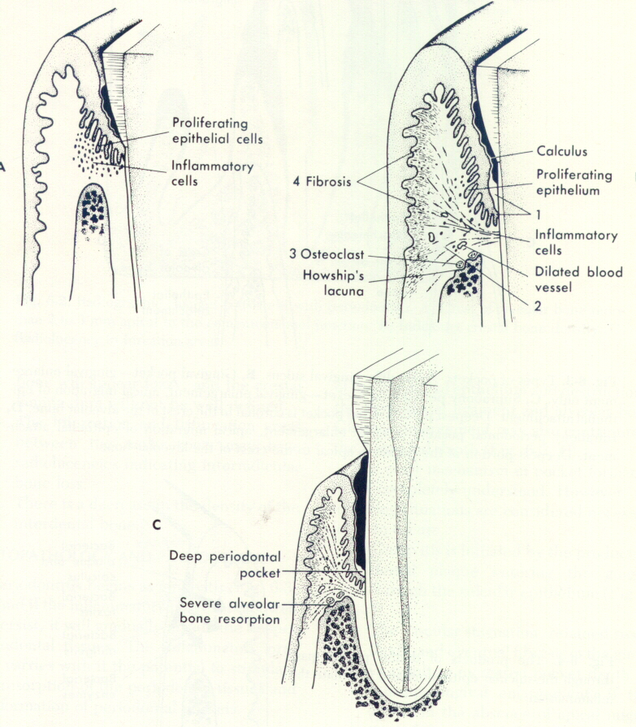

Slide 8
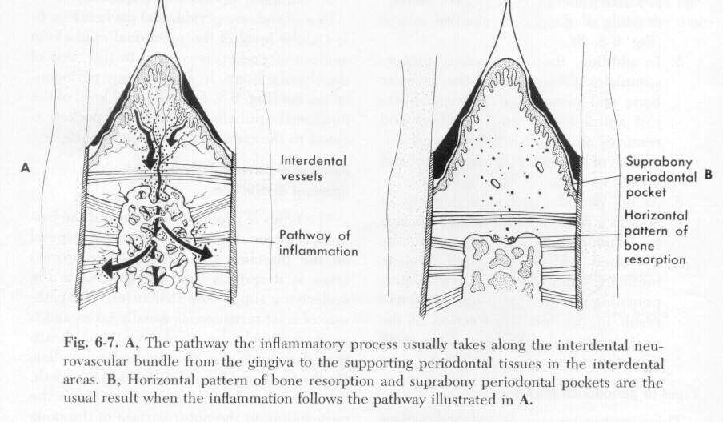

Slide 9
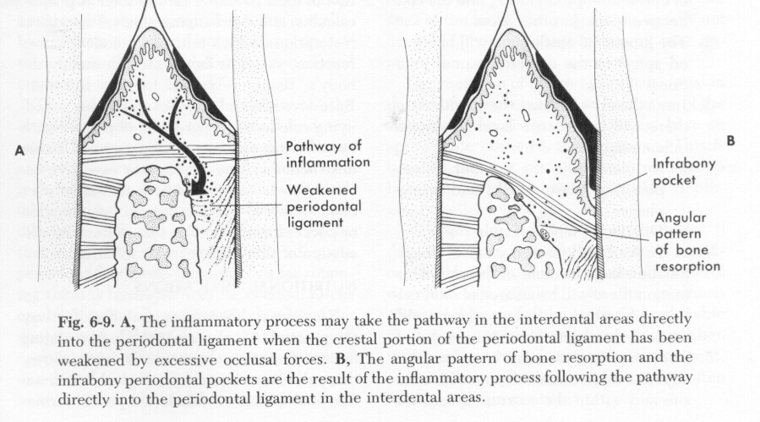

Slide 10
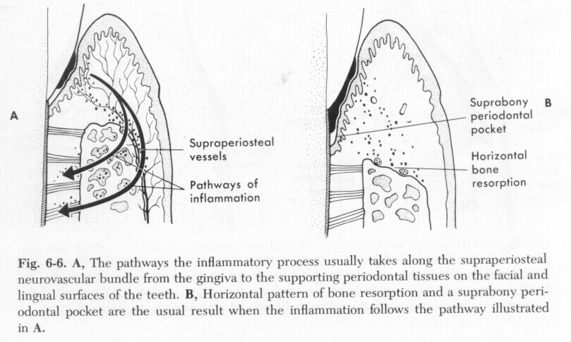

Slide 11
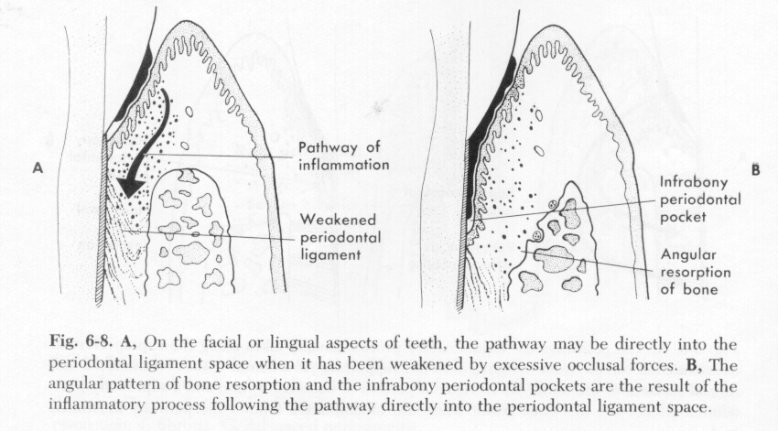

Slide 12
Bone Loss
Extension Of Gingival Inflamation
In to The Supporting Periodontal Tissue

Slide 13
Rate Of Lone Loss
Loe :
A: 0.2 mm Facial Surface
B: 0.3mm Proximal Surface
If Disease Untreated

Slide 14
LOE et al:
1.Approximately 8% Had Rapid Progression
characterized By Alveolar Loss Of Attachment Of 0.1 to 1mm
2.A proximately 81 % had moderate progression with a yearly loss of attachment of 0.05 to 0.5
3. 11% had minimal or no progression of destructive disease (0.05 to 0.09 mm yealy)

Slide 15
Period of destruction
Destruction occurs in an episodic Intermitant fashion with period of inactivity

Slide 16
Four theories for the onset of destructive period

Slide 17
Burst of desturctive activity are Associated with subgingival ulceration And an acut inflammatory reaction , Resulting in rapid loss of alveolar Bone

Slide 18
* Burst of destruction activity Coincide with the conversion of a Predominance tlymphocyte lesion to One with a predominance of b Iymphocyte plasma cell infiltrate

Slide 19
Period of exacerbation are associated
With an Increased of the loss– unattached
Motile gram– negative , unaerobic pocket flora And period of remission coincidewith the Formation of adense unattached non motile Gram positive flora with a tendency to Mineralized .

Slide 20
Tissue Invasion by one or Several bacterial species is Followed by advanced Local host defense that Controls the attack .

Slide 21
Factors Determinig Bone Morphology In Periodontal Disease
Normal Variation:
A : The Thickness , Width And crestal Angulation Of The Inter Dental Septa
B : The Thickness Of The Facial And Lingual Alveolar Plates
C : The Presence Of Fenestration , Dehiscences Or Both
D : The Alignment Of The Teeth
E : Root And Root Trunk Anatomy
F : Root Position within The Alverlar Process
G : Proximity With Another Tooth Surface

Slide 22
Exostoses
Palatal Exostoses 40%
Mandibular torous

Slide 23
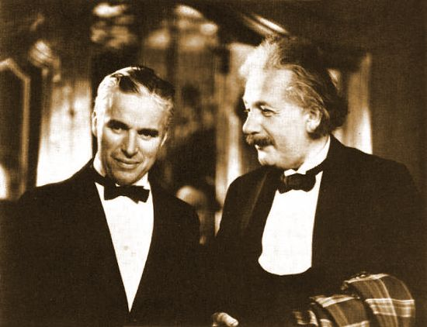

Slide 24
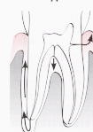
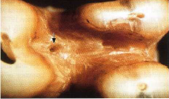
Trauma From Occlusion

Slide 25
Central Peripheral (Lipping )
Buttressing Bone formation

Slide 26
Food Impaction

Slide 27
Patterns Of Bone Destruction

Slide 28
Horizontal Bone Loss Vertcal Bone Loss

Slide 29
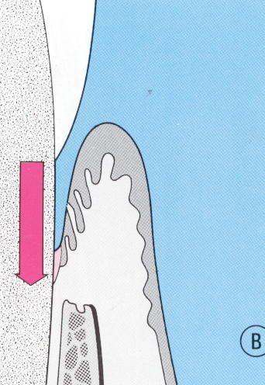
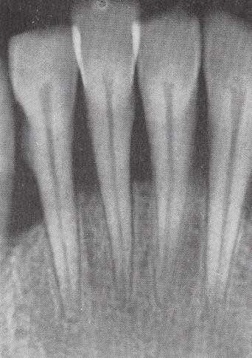
The Most Common Pattern Of Bone loss Bone is Reduced In Height

Slide 30
Bone Deformities (Ossous Defects )
Radiographs
Care Full Probing
Surgical Exposure

Slide 31
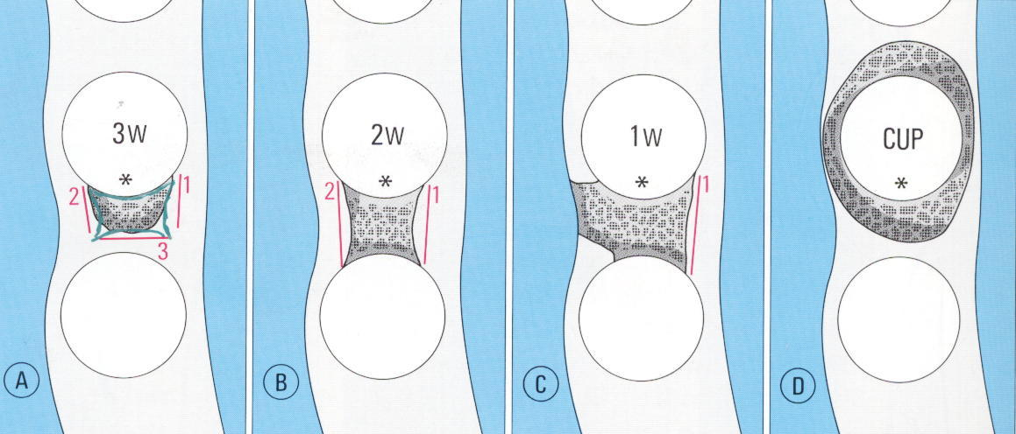
Vertical or angular defect
Number Of Osseous Wall
One Wall Defect
Two Wall Defect
Three Wall Defect

Slide 32
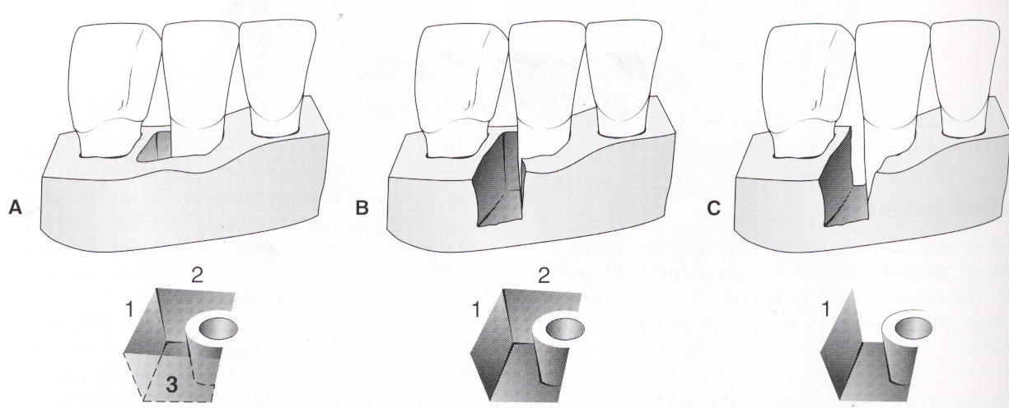
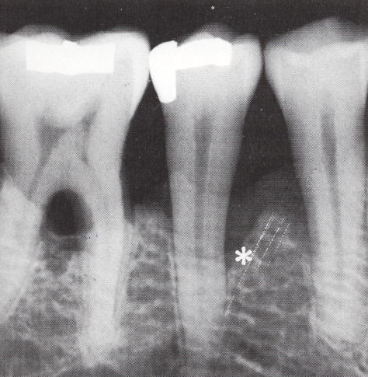
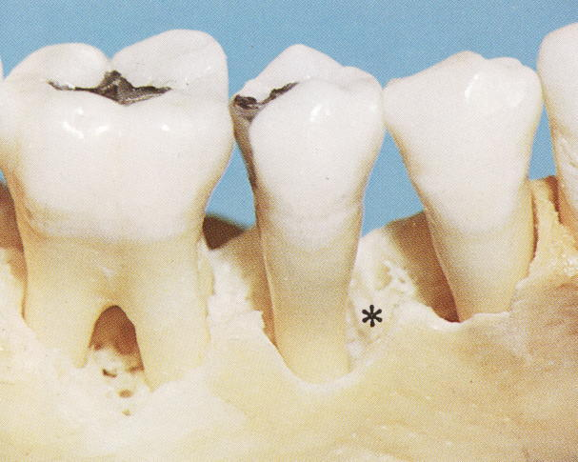
One wall defect (hemi septum)

Slide 33
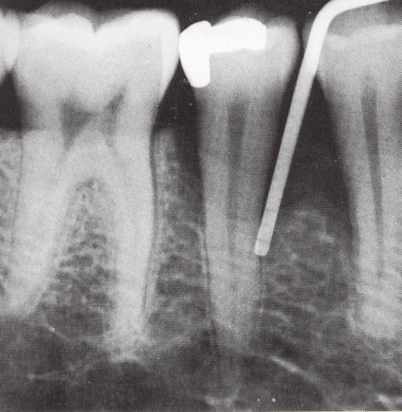
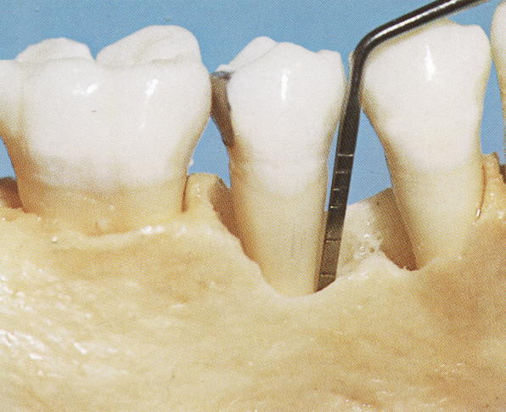
Two wall defect

Slide 34
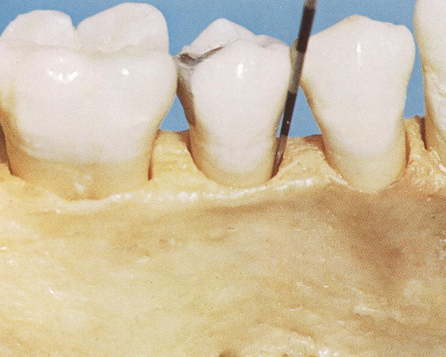
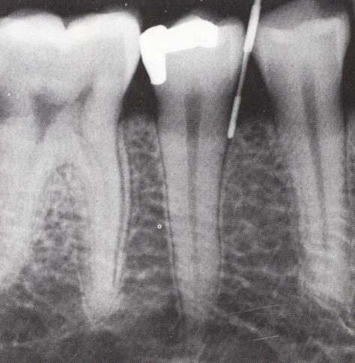
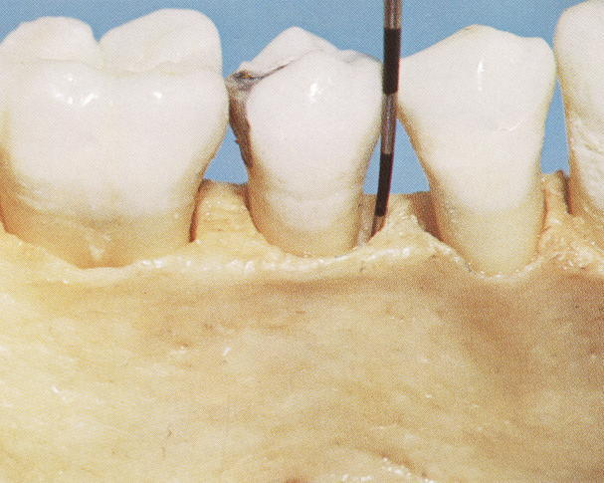
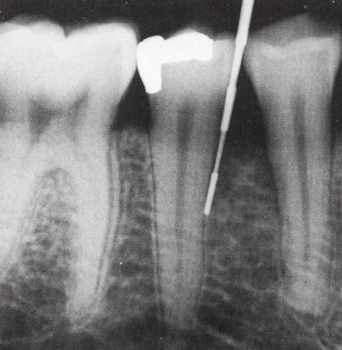
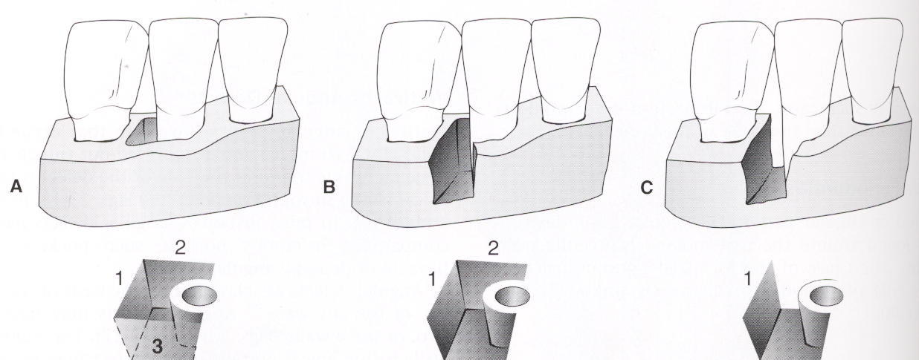
Three wall defect (Intra bony defect )
Mesial of second and third maxillary and Mandibular molars

Slide 35
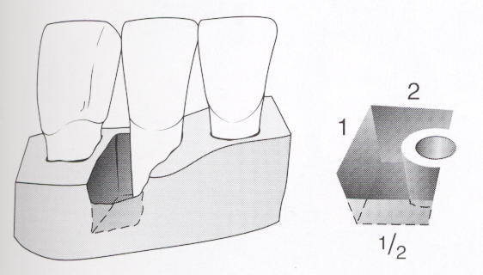
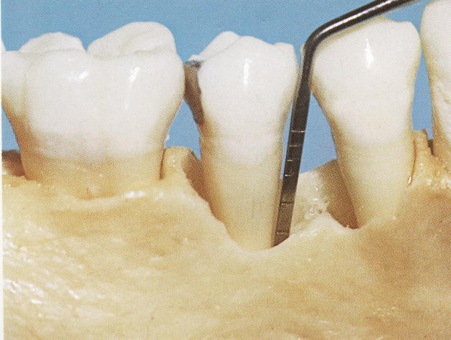
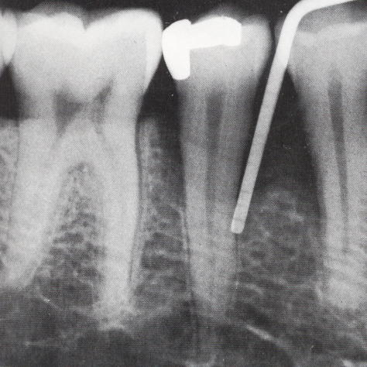
Combind defect

Slide 36
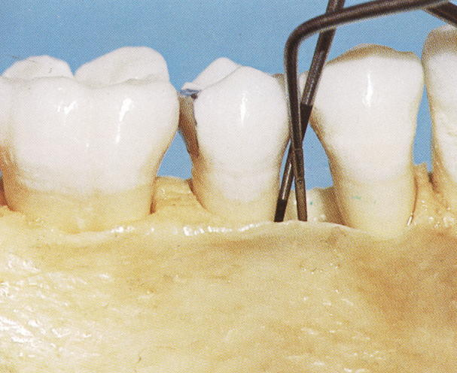
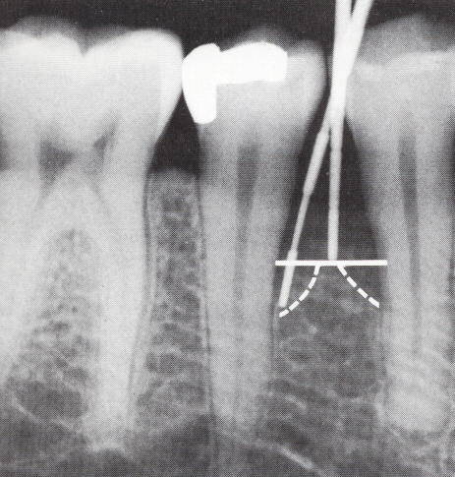
Osseous craters
1/3 Of all defect
2/3 Of all mandibular defect
Twice in posterior as anterior segment

Slide 37
Reasons for high frequency of craters
A . The inter dental area collects plaque and is difficult to clean
B . The normal flat or even concave faciolingual shape of the inter dental septum in lower molars may favor crater formation
C . Vascular paterns from the gingiva to the center of the crest may provide a pathway for inflammation

Slide 38
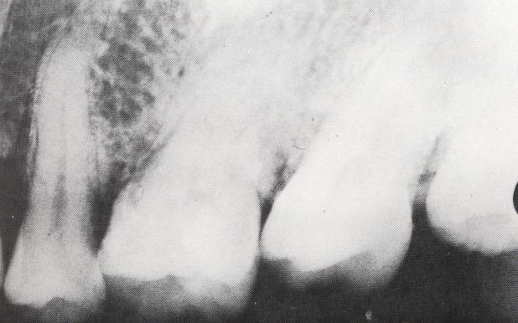
Bulbuas bone contours
Exostoses
Buttresing bone formation
More common in maxilla than in the mandibule

Slide 39
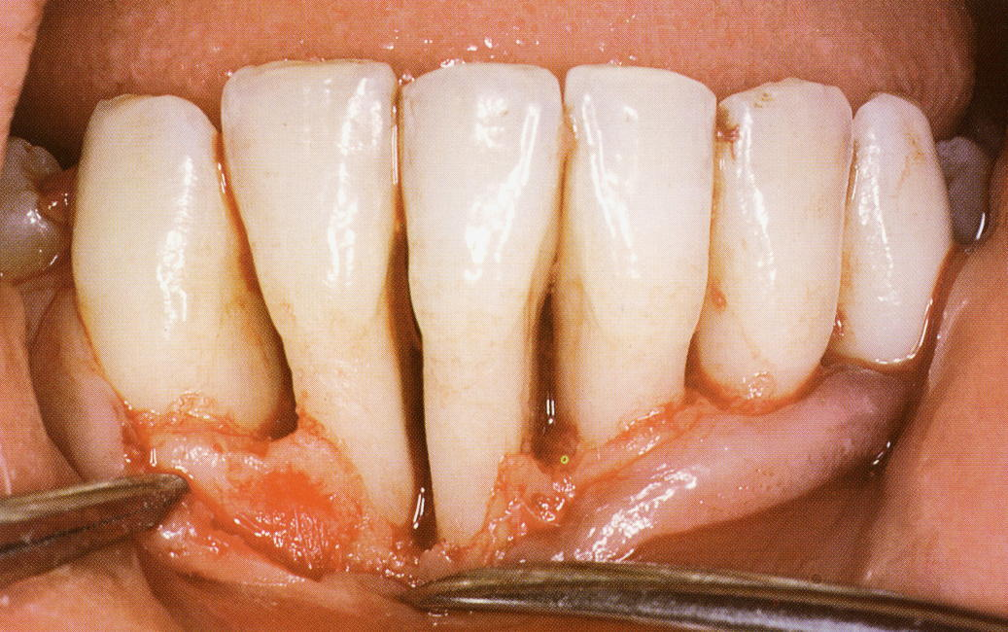
Reversed architecture
Loss of inter dental septum without
Loss of lingual and buccal plates
More common in maxilla

Slide 40
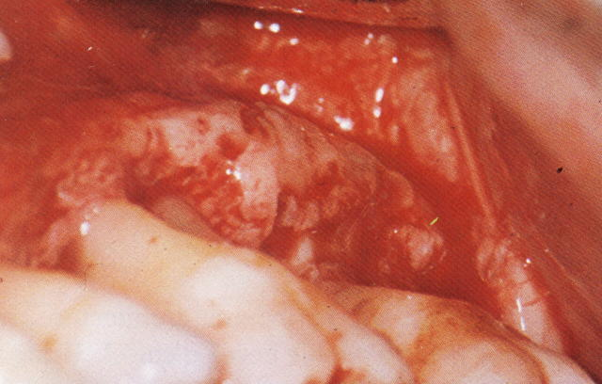
Ledges
Plateau—like bone margin caused by
Resorption of thickend bony plates

Slide 41
Furcation involvement
Horizontal defect ( I , II , III , IIII )
Vertical defect ( A , B , C ) Tarnow

Slide 42
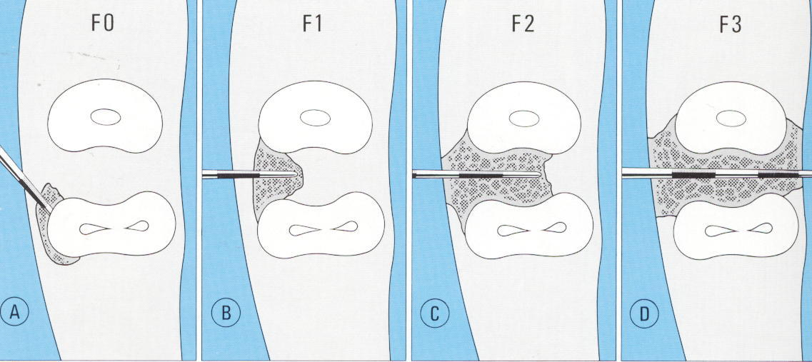
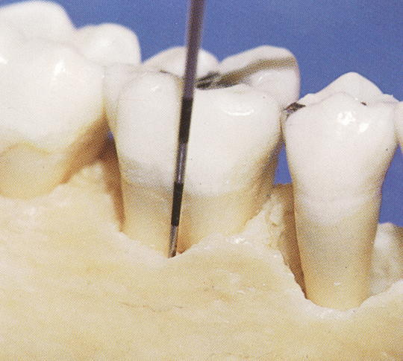
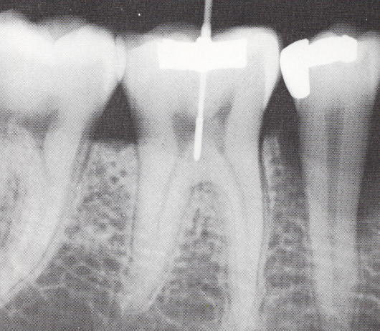
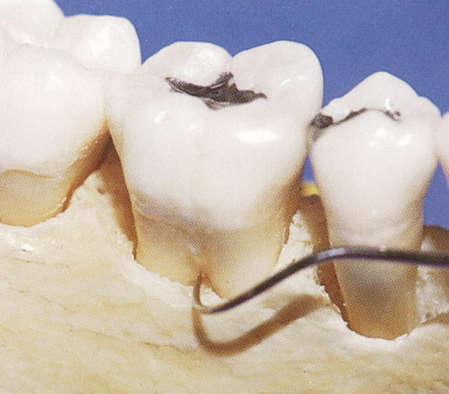
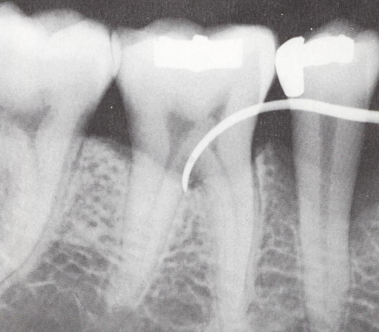

Slide 43
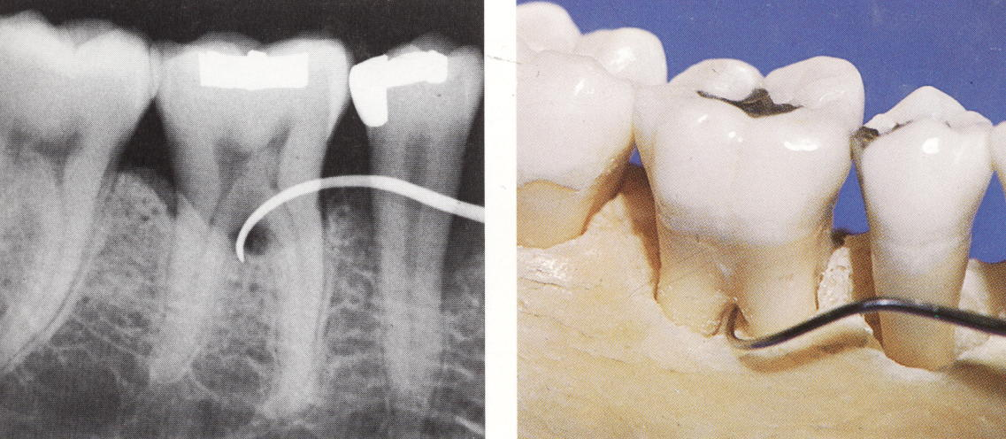
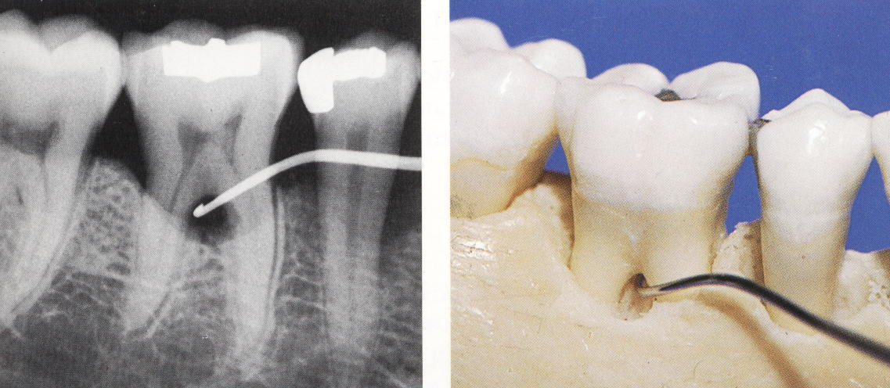
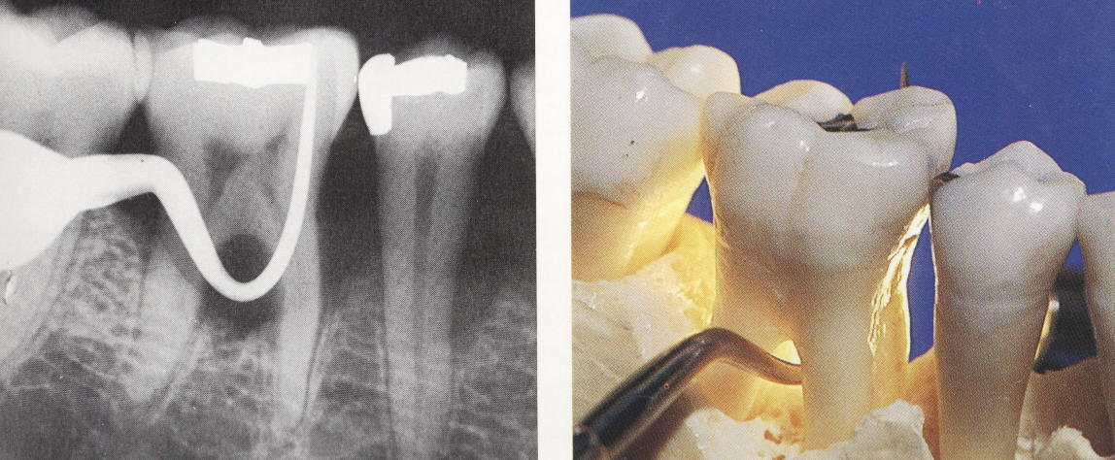

Slide 44
